Slide 1
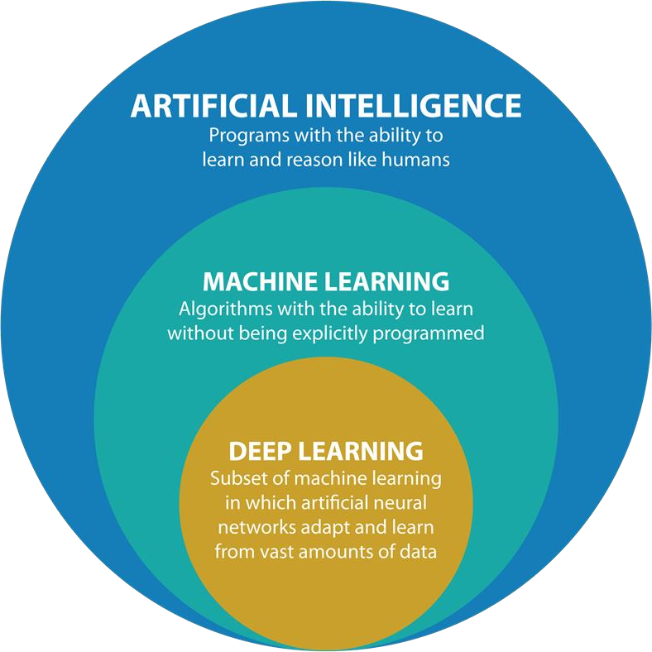

Slide 2
AI Vs ML Vs DL
In AI we are mimicking human intellect and behavior
In ML we are making machines to learning without explicitly being programmed
In DL we are making machines to learning based on artificial neural networks

Slide 3
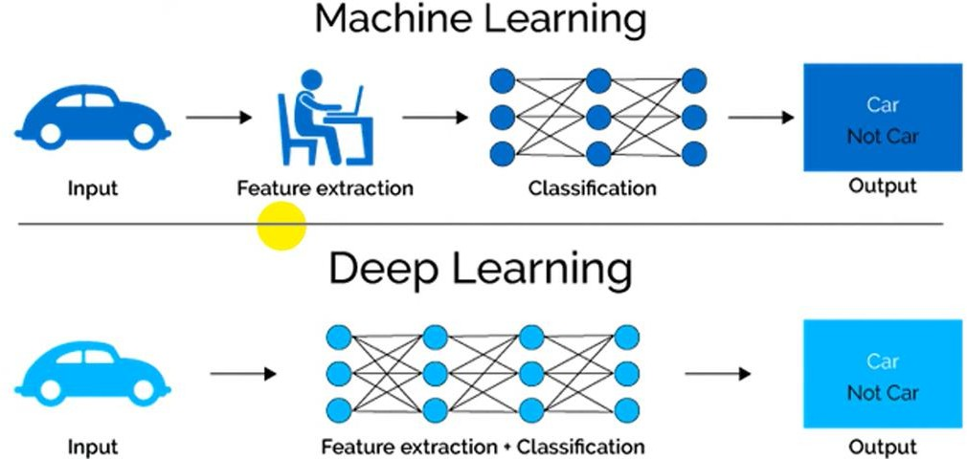

Slide 4

Revising ML Concepts
Human can learn from past experience and make decision of its own

Slide 5
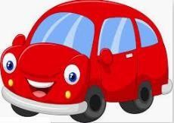
What is this object?

Slide 6
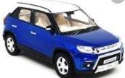

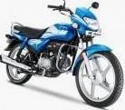
What is this?
CAR
CAR
BIKE
BIKE
This is a CAR

Slide 7
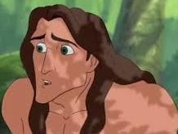

Let us ask the same question to him
What is this?

Slide 8

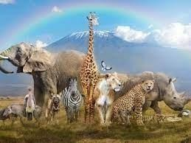
Let us ask the same question to him
?
What is this?

Slide 9
[ But, he is a human being. He can observe and learn ]

Slide 10


show him

Slide 11
CAR
show him
CAR
BIKE
BIKE

Slide 12
What is this?
CAR
CAR BIKE BIKE
Past experience
10

Slide 13

Let us ask the same question now
CAR
What is this?
CAR
CAR BIKE BIKE

Slide 14

What about a Machine ?
Machines follow instructions
It can not take decision of its own

Slide 15
What about a Machine ?
We can ask a machine
To perform an arithmetic operations such as
  Addition
  Multiplication
  Division
Machines follow instructions

Slide 16
What about a Machine ?
Comparison
Print
Machines follow instructions

Slide 17
What is Machine Learning?
We want a machine to act like a human

Slide 18
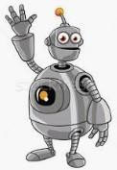
What is Machine Learning?
Identify this object

Slide 19
What is Machine Learning?
Price in 2025?
Predict the price

Slide 20
What is Machine Learning?
I made met him yesterday
Natural language understand, and correct grammar

Slide 21
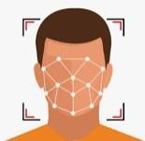
What is Machine Learning?
recognize face
Recognize faces

Slide 22
What is Machine Learning?
What do we do?
Just like, what we did to human, we need to
provide experience to the machine.

Slide 23
What is Machine Learning?
First need to provide training
dataset to the machine
+
Dataset

Slide 24

What is Machine Learning?
+
+
Then, devise algorithms and execute programs on the data with respect to the underlying target tasks
Dataset

Slide 25

What is Machine Learning?
+
+
+
Then, using the programs, identify rules
Dataset

Slide 26

What is Machine Learning?
+
+
+
Extract required patterns
Dataset

Slide 27

What is Machine Learning?
+
+
+
Dataset
Identify relations

Slide 28
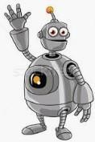
+
What is Machine Learning?
=
+
+
Dataset
So that machine can derive inferences from the data

Slide 29
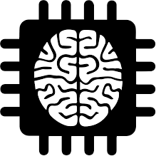

In summary, what is machine learning?
Given a machine learning problem
Identify and create the appropriate dataset
Perform computation to learn
  Required rules, pattern and relations
Output the decision

Slide 30
Machine Learning Paradigms
Supervised
Unsupervised Learning
Reinforcement learning
We as human being solve various types of problem in our day-to-day life, Various decisions need to be taken.
Depending on the nature of the problem, machine learning tasks can be broadly divided in three categories.

Slide 31
What is Supervised Learning?
CAR
+
CAR
= Training Dataset
BIKE
BIKE
Samples
Labels
In supervised learning, we need some thing called a Labelled Dataset

Slide 32
= Training Dataset
CAR
+
CAR
𝑓( , )=
BIKE
BIKE
Samples
Labels

Slide 33

= Training Dataset
CAR
+
CAR
𝑓(
, )
=
BIKE
BIKE
Samples
Labels

Slide 34
= Training Dataset
CAR
+
CAR
𝑓( , )= CAR
BIKE
BIKE
Samples
Labels

Slide 35
CAR
Classification
𝑓( , )= CAR
+
CAR
= Training Dataset
BIKE
BIKE
Samples Labels
If the possible output values of the function are predefined and discrete/categorical, it is called classification.
33

Slide 36
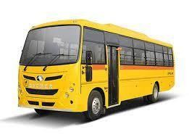
CAR
Classification
𝑓( , )= CAR
+
CAR
= Training Dataset
BIKE
BIKE
Samples
Labels
Predefined classes means, it will produce output only from the labels defined in the dataset. For example, even if we input a bus, it will produce either CAR or BIKE

Slide 37
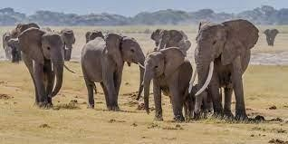
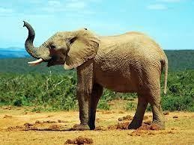
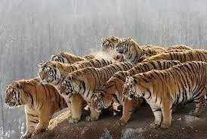
Classifier
Elephant
Tiger
Elephant
Classifier
Identify the Animal ?
Dataset

Slide 38
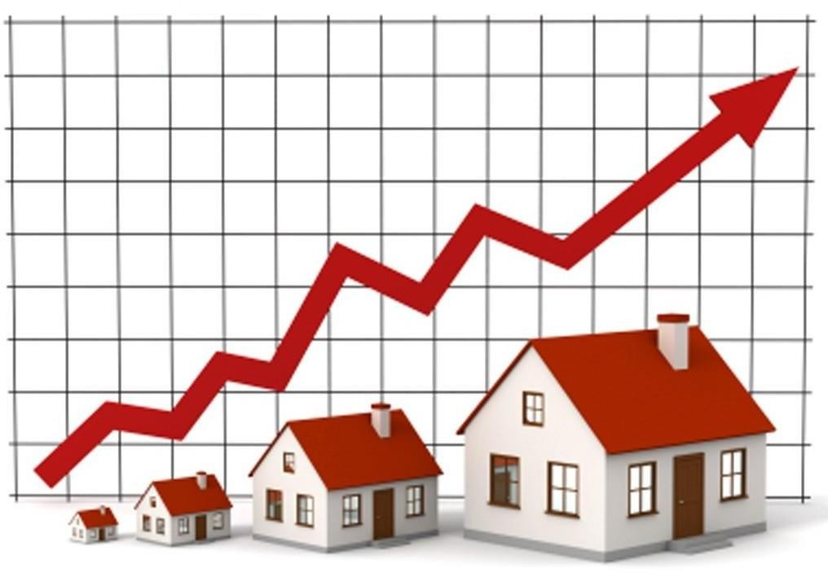
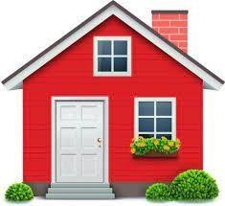
Regression
Regression
𝑓( , )= 20500.50
Dataset
[ If the possible output values of the function are continuous real values, then it is called Regression

Slide 39
The classification and Regression problems are supervised, because the decision depends on the characteristics of the ground truth labels or values present in the dataset, which we define as experience

Slide 40
What is Unsupervised Learning
CAR
CAR BIKE BIKE
Dataset
In unsupervised learning, we do not need to know the labels or Ground truth values .

Slide 41
Clustering
Dataset
The task is to identify the patterns like group the similar objects together
39

Slide 42

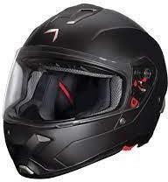
What is Unsupervised Learning
Association Rules Mining
Dataset

Slide 43
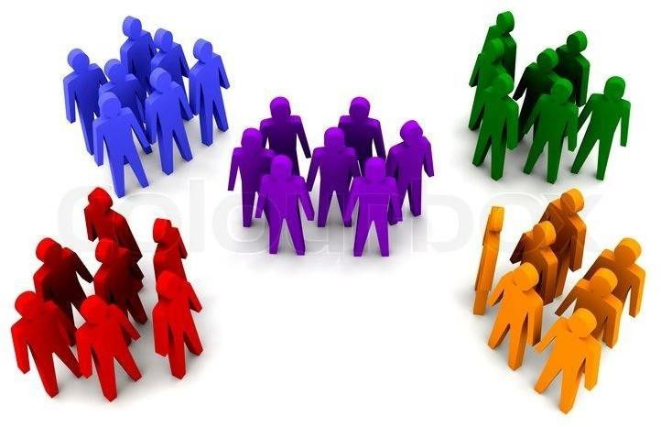
More Example Unsupervised Learning
Dataset

Slide 44
More Example Unsupervised Learning
Dataset

Slide 45


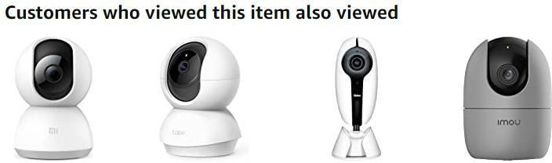
More Example Unsupervised Learning

Slide 46
What is Reinforcement Learning
[ It is also known as learning from trials and errors ]

Slide 47


What is Reinforcement Learning

Slide 48

What is Reinforcement Learning

Slide 49


What is Reinforcement Learning

Slide 50

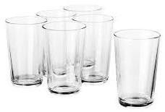




Another Example
Agent
Task
Environment

Slide 51

Reinforcement Learning
Punishment

Slide 52

Reinforcement Learning
Reward

Slide 53
Reinforcement Learning
Reward
Baby Learn from the Trials and Errors
Reinforcement Learning

Slide 54
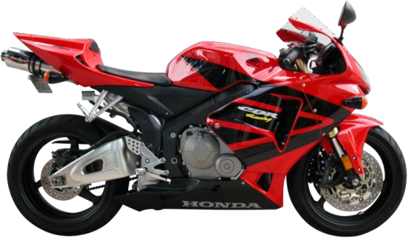
Machine Learning
Input: X
Output: Y
Label”motorcycle”

Slide 55
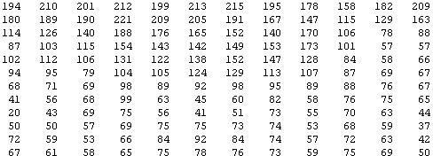
Why is it hard?
You see this
But the camera sees this:

Slide 56


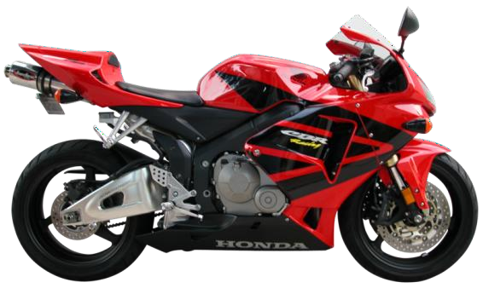
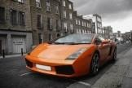
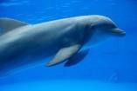
Raw Image Representation
pixel 1
Learning Algorithm
pixel 2
pixel 2
Cars
“Non”-‐Cars
pixel 1

Slide 57
Raw Image Representation
pixel 1
Learning Algorithm
pixel 2
pixel 2
Cars
“Non”-‐Cars
pixel 1

Slide 58
Raw Image Representation
pixel 1
Learning Algorithm
pixel 2
pixel 2
Cars
“Non”-‐Cars
pixel 1

Slide 59
Better Feature Representation?
handles
Learning Algorithm
wheel
Cars
“Non”-‐Cars
pixel 2
handles
pixel 1
wheel

Slide 60
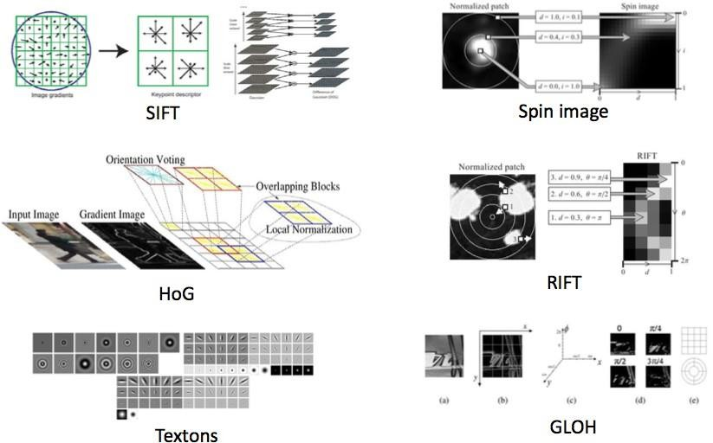
Feature Representations
Expert Knowledge!

Slide 61
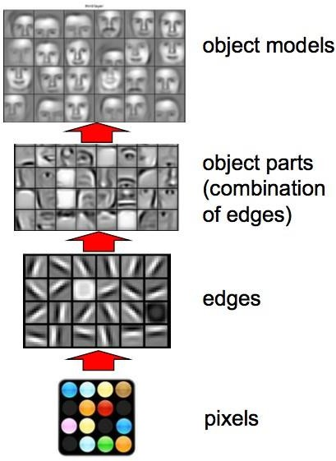
Deep Learning: learn representations!

Slide 62
So, 1. what exactly is deep learning
?
And, 2. why is it generally better than other methods on image, speech, and certain other data types?
The short answers
Deep Learning’ means using a neural network with several
layers of nodes between input and output
The series of layers between input & output feature identification and processing in a series of stages the same as our brains.

Slide 63
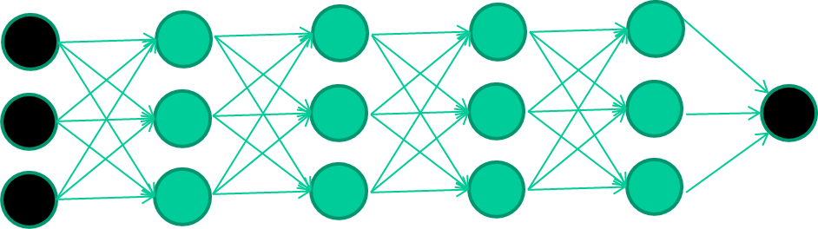
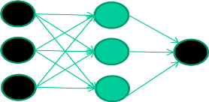
hmmm… OK, but:
3. Multilayer neural networks have been around for 25 years. What’s actually new?
Single layer algorithms are not good at learning the weights for
networks with more hidden layers
what’s new is: algorithms for training many-‐later networks

Slide 64
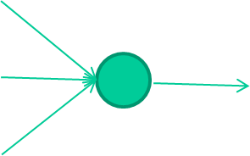
Single Unit, Input, weights, activation function, output
Bias x0
w0
f(x) = g(w₀ x₀+ w₁ x₁+ w₂ x₂ )
w1
f(x)
Input x1
output
w2
Activation functions:
linear
Sigmoid
Tanh
Relu
Softmax etc.
Input x2

Slide 65
A dataset
Fields
class
1.4 | 2.7 | 1.9 | 0
3.8 | 3.4 | 3.2 | 0
6.4 | 2.8 | 1.7 | 1
4.1 | 0.1 | 0.2 | 0
etc …
Train the deep neural network

Slide 66
A dataset
Fields
class
1.4 | 2.7 | 1.9 | 0
3.8 | 3.4 | 3.2 | 0
6.4 | 2.8 | 1.7 | 1
4.1 | 0.1 | 0.2 | 0
Initialize with random weights
etc …
1.4
2.7
0.7 (0)
Error=0.7
1.9
Compare with the target output

Slide 67





Adjust weights based on error
1.4
2.7
0.7 (0)
Error=0.7
1.9
Repeat this thousands, maybe millions of times – each time taking a random training instance, and making slight weight adjustments
Algorithms for weight adjustment are designed to make changes that will reduce the error

Slide 68
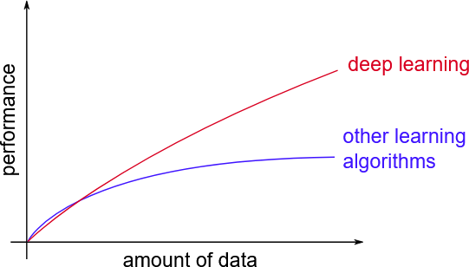
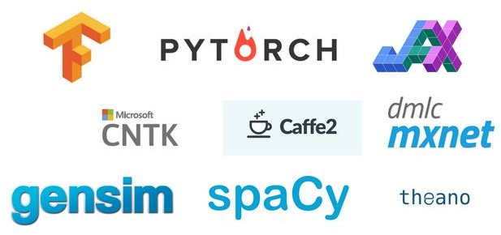
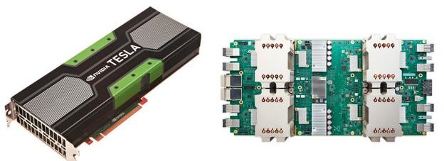
Why Deep Learning Now
Better algorithms and Understanding
Computing Power(GPUs, TPUs)
Data with labels
OneSource tools and models

Slide 69
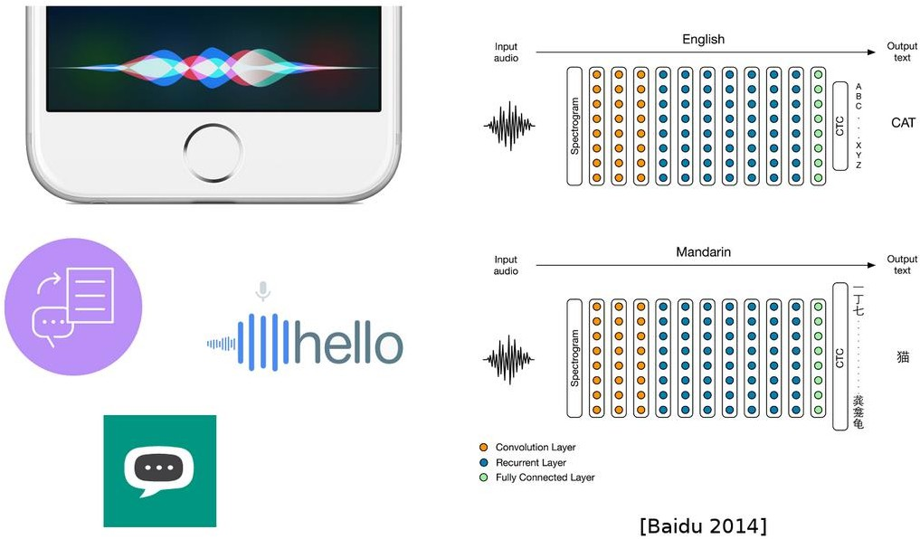
DL Today: Speech to Text

Slide 70
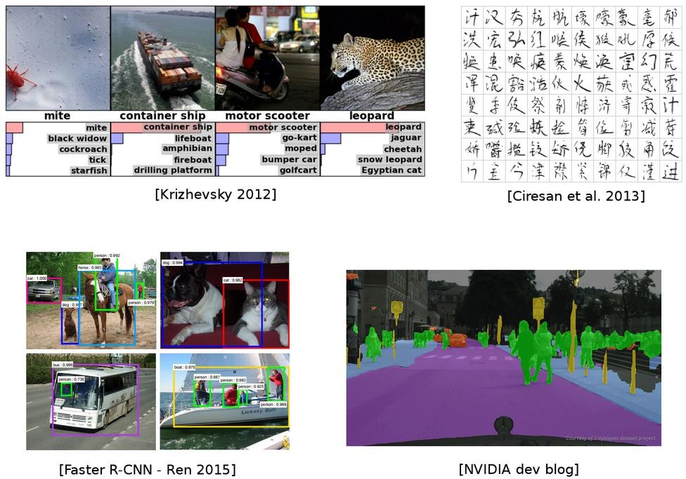
DL Today: Vision

Slide 71
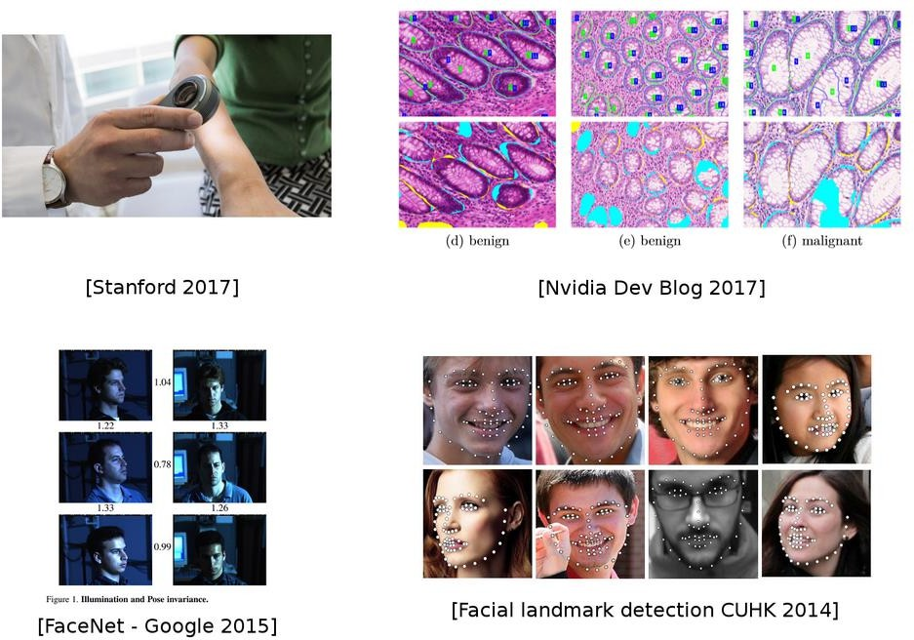
DL Today: Vision

Slide 72
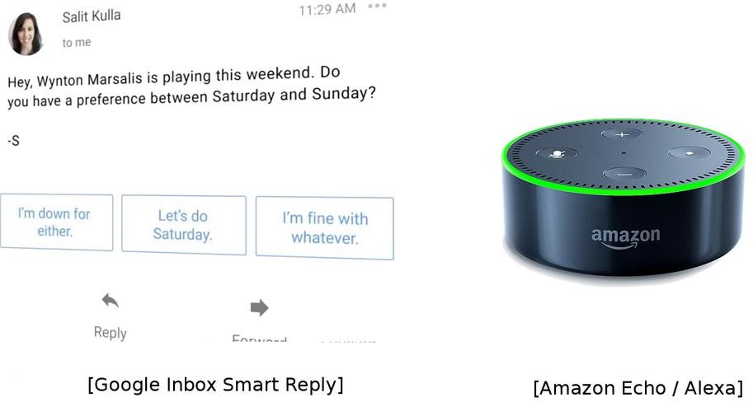
DL Today: NLP

Slide 73
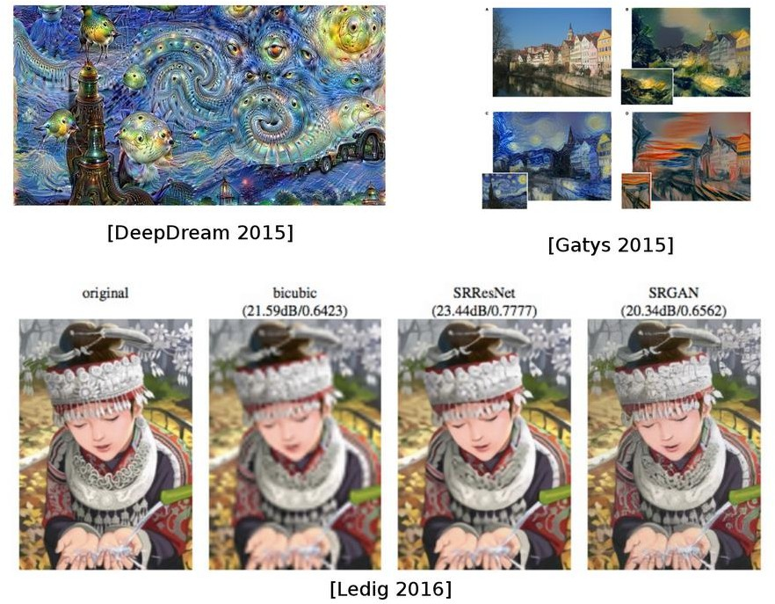
DL Today: Image Translation

Slide 74
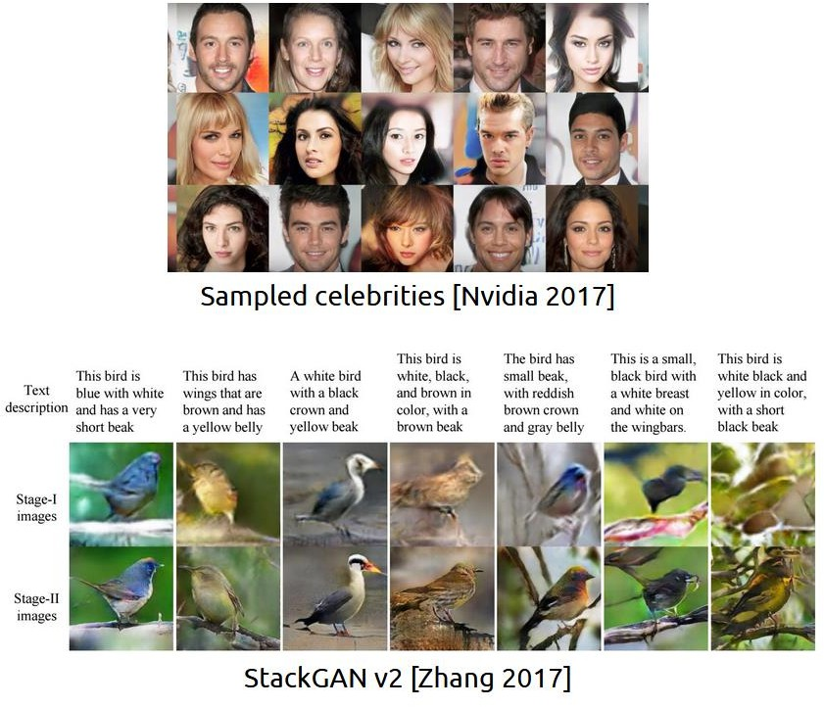
DL Today: Generative Models

